Slide 1
Microsoft Visual C#: An Introduction to Object-Oriented Programming
7th Edition
Chapter 3
Using GUI Objects and the Visual Studio IDE
© 2018 Cengage. All Rights Reserved. May not be copied, scanned, or duplicated, in whole or in part, except for use as permitted in a license distributed with a certain product or service or otherwise on a password-protected website for classroom use.

Slide 2
Objectives
3.1 Create a Form in the Visual Studio IDE
3.2 Use the Toolbox to add a Button to a Form
3.3 Add Labels and TextBoxes to a Form
3.4 Name Forms and controls
3.5 Correct errors
3.6 Decide which interface to use
© 2018 Cengage. May not be copied, scanned, or duplicated, in whole or in part, except for use as permitted in a license distributed with a certain product or service or otherwise on a password-protected website for classroom use.

Slide 3
Creating a Form in the IDE (1 of 8)
The interface is the environment the user sees
Forms are rectangular graphical user interface (GUI) objects that provide an interface for collecting, displaying, and delivering information
Forms always include controls
Devices such as labels, text boxes, and buttons
To create a Form:
Select New Project after starting Visual Studio
Then choose Windows Forms App
After you click OK in the New Project window, you see the IDE main window (see Figure 3-2)
© 2018 Cengage. May not be copied, scanned, or duplicated, in whole or in part, except for use as permitted in a license distributed with a certain product or service or otherwise on a password-protected website for classroom use.

Slide 4
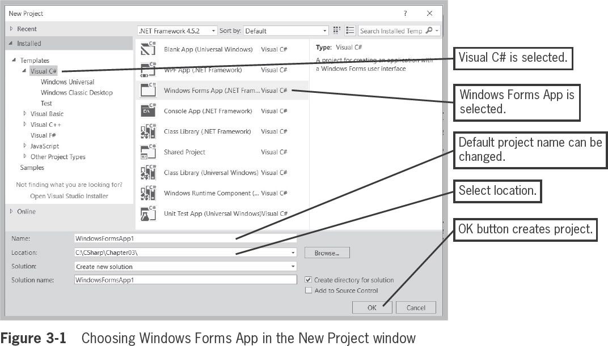
Creating a Form in the IDE (2 of 8)
© 2018 Cengage. May not be copied, scanned, or duplicated, in whole or in part, except for use as permitted in a license distributed with a certain product or service or otherwise on a password-protected website for classroom use.

Slide 5
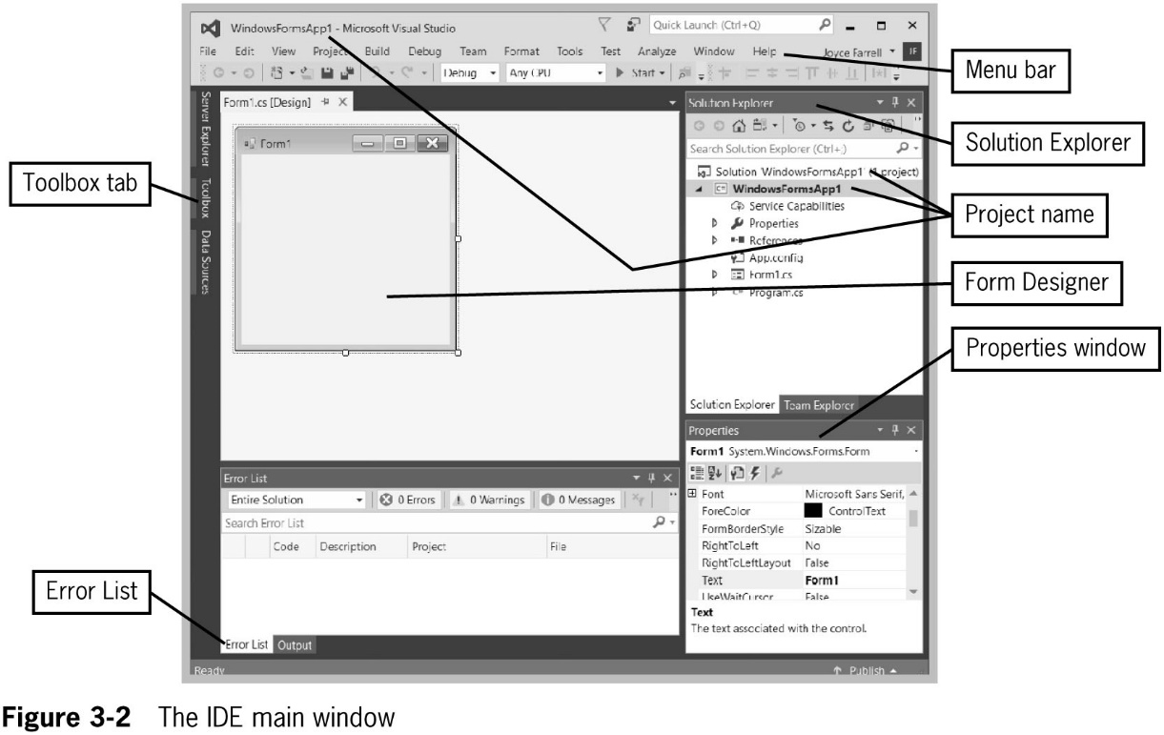
Creating a Form in the IDE (3 of 8)
© 2018 Cengage. May not be copied, scanned, or duplicated, in whole or in part, except for use as permitted in a license distributed with a certain product or service or otherwise on a password-protected website for classroom use.

Slide 6
Creating a Form in the IDE (4 of 8)
The name of the project shows in three places: the title bar, the Solution Explorer, and the Properties window
The menu bar lies horizontally across the top
The Toolbox tab provides a list of controls you can drag onto a Form
The Form Designer appears in the center of the screen
The Solution Explorer allows viewing and management of project files and settings
The Properties window is for configuring properties and events on controls in your user interface
The Error list displays messages about compiler errors in your code
© 2018 Cengage. May not be copied, scanned, or duplicated, in whole or in part, except for use as permitted in a license distributed with a certain product or service or otherwise on a password-protected website for classroom use.

Slide 7
Creating a Form in the IDE (5 of 8)
When you create a Windows Forms project
Visual C# adds a form to the project and calls it Form1
After you click the Form in the Form Designer area, you can see the name of the form in the following locations:
On the folder tab at the top of the Form Designer area
In the title bar of the form in the Form Designer area
In the Solution Explorer file list
At the top of the Properties window indicating that the properties listed are for Form1
As the contents of the Text property listed within the Properties window
© 2018 Cengage. May not be copied, scanned, or duplicated, in whole or in part, except for use as permitted in a license distributed with a certain product or service or otherwise on a password-protected website for classroom use.

Slide 8
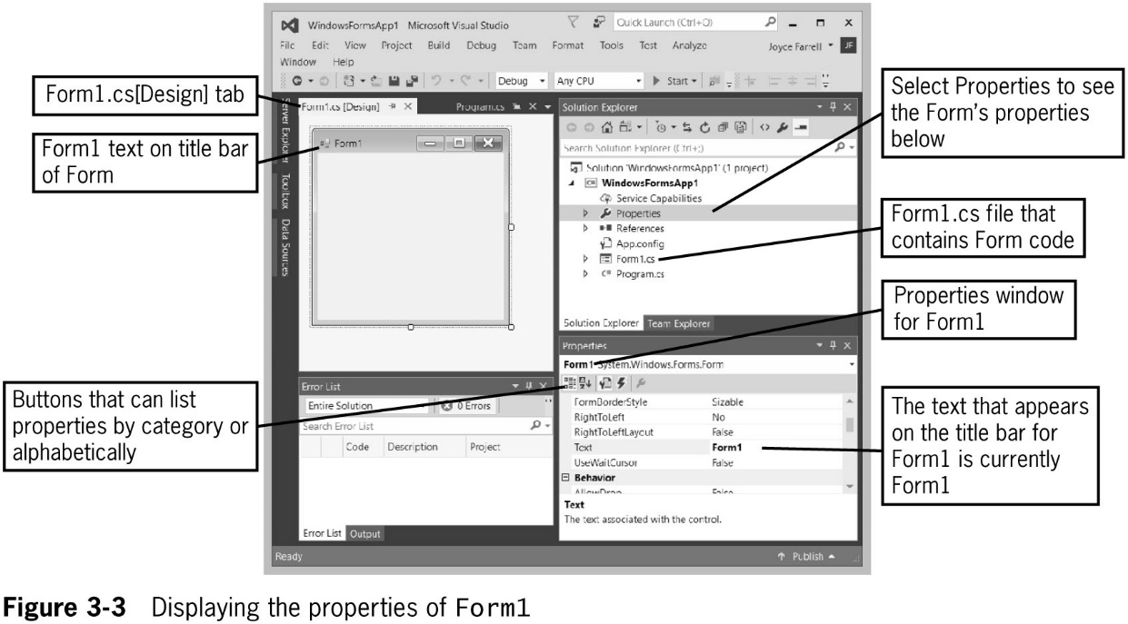
Creating a Form in the IDE (6 of 8)
© 2018 Cengage. May not be copied, scanned, or duplicated, in whole or in part, except for use as permitted in a license distributed with a certain product or service or otherwise on a password-protected website for classroom use.

Slide 9
Creating a Form in the IDE (7 of 8)
In the Properties window, you can change the appearance, size, and color of a window
The Form class contains around 100 properties
When you sort Properties in alphabetical order in the Properties window
The Name entry is not in alphabetical order
It appears near the top of the list in parentheses
© 2018 Cengage. May not be copied, scanned, or duplicated, in whole or in part, except for use as permitted in a license distributed with a certain product or service or otherwise on a password-protected website for classroom use.

Slide 10
Creating a Form in the IDE (8 of 8)
Do not confuse a Form’s Name with its Text property
If you change a Form’s Name, you don’t notice any difference in the visual design
All references to the form are changed in the code
A Form’s Name is an identifier and it must follow rules for variable names
A Form’s Text is what appears in its title bar
It can be any string
© 2018 Cengage. May not be copied, scanned, or duplicated, in whole or in part, except for use as permitted in a license distributed with a certain product or service or otherwise on a password-protected website for classroom use.

Slide 11
Using the Toolbox to Add a Button to a Form (1 of 4)
When you open the IDE, the left border displays a Toolbox tab
Open the toolbox, and a list of tool groups is displayed
The tool groups include the controls you have seen when using a Windows application
Selecting All Windows Forms at the top of the Toolbox
Displays a complete list of available tools
Selecting Common Controls
Displays a smaller list that is a subset of the original one
© 2018 Cengage. May not be copied, scanned, or duplicated, in whole or in part, except for use as permitted in a license distributed with a certain product or service or otherwise on a password-protected website for classroom use.

Slide 12
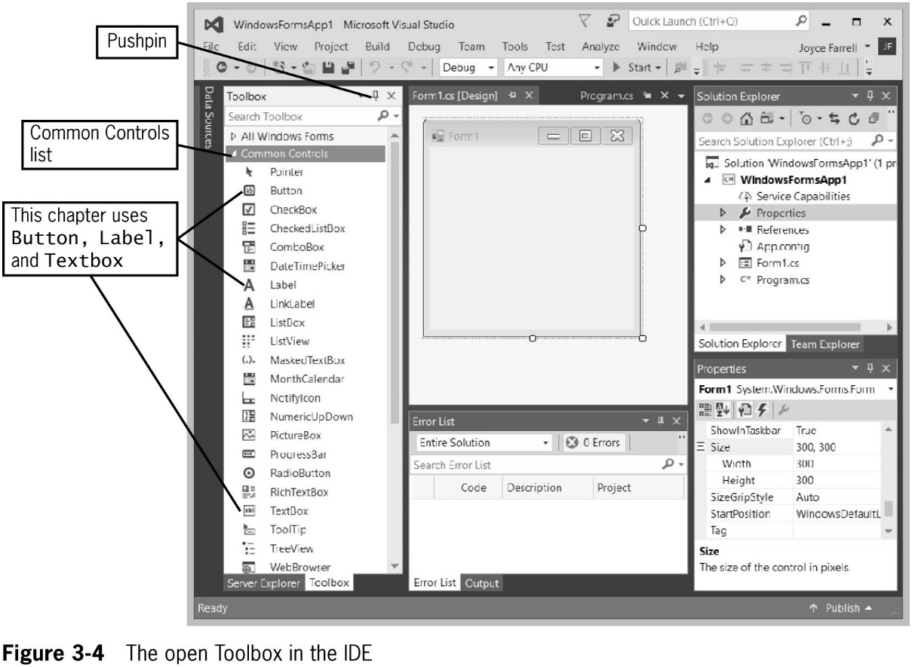
Using the Toolbox to Add a Button to a Form (2 of 4)
© 2018 Cengage. May not be copied, scanned, or duplicated, in whole or in part, except for use as permitted in a license distributed with a certain product or service or otherwise on a password-protected website for classroom use.

Slide 13
Using the Toolbox to Add a Button to a Form (3 of 4)
You can drag controls (such as a Button) onto a Form
You can relocate a control by dragging it, or delete it by selecting it and pressing the Del key
Once a programmer has dragged a control onto a form
It is given a default name
In a professional application, you would probably want to change the Name property of the control to a unique and memorable identifier
When you click on a control, the Properties window shows its properties
© 2018 Cengage. May not be copied, scanned, or duplicated, in whole or in part, except for use as permitted in a license distributed with a certain product or service or otherwise on a password-protected website for classroom use.

Slide 14
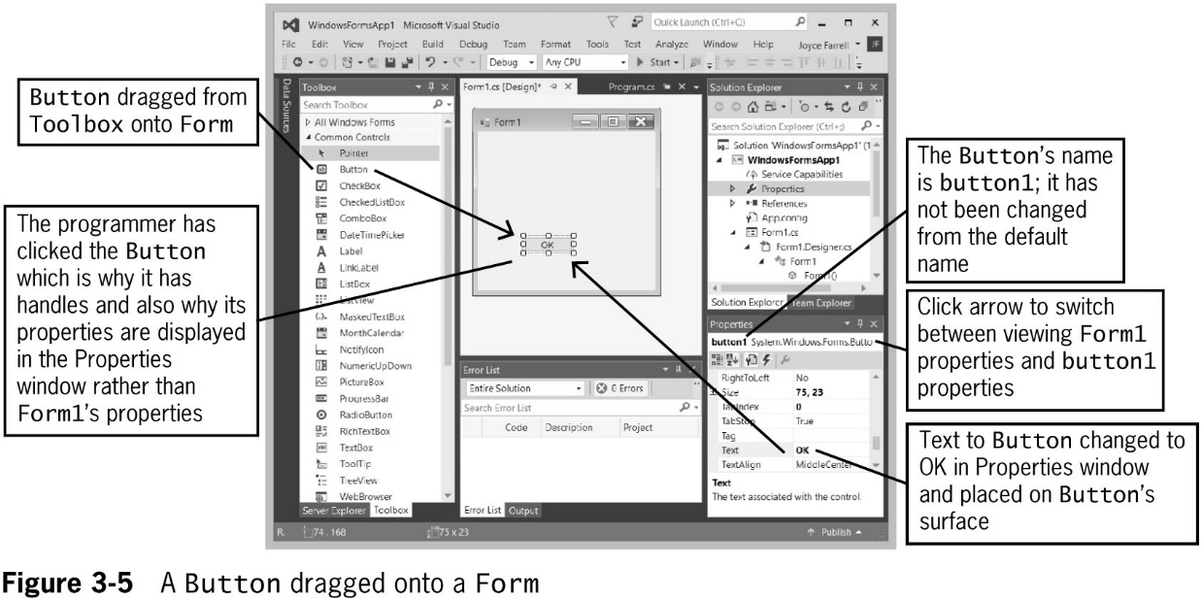
Using the Toolbox to Add a Button to a Form (4 of 4)
© 2018 Cengage. May not be copied, scanned, or duplicated, in whole or in part, except for use as permitted in a license distributed with a certain product or service or otherwise on a password-protected website for classroom use.

Slide 15
Adding Functionality to a Button on a Form (1 of 5)
Adding functionality to a Button is easy with the IDE
After dragging the Button onto a Form, you double-click on it to create a method that executes when the user clicks the Button
You can view the Form Designer by selecting View and then Designer from the menu bar
You can view the code by selecting View and then Code from the menu bar
© 2018 Cengage. May not be copied, scanned, or duplicated, in whole or in part, except for use as permitted in a license distributed with a certain product or service or otherwise on a password-protected website for classroom use.

Slide 16
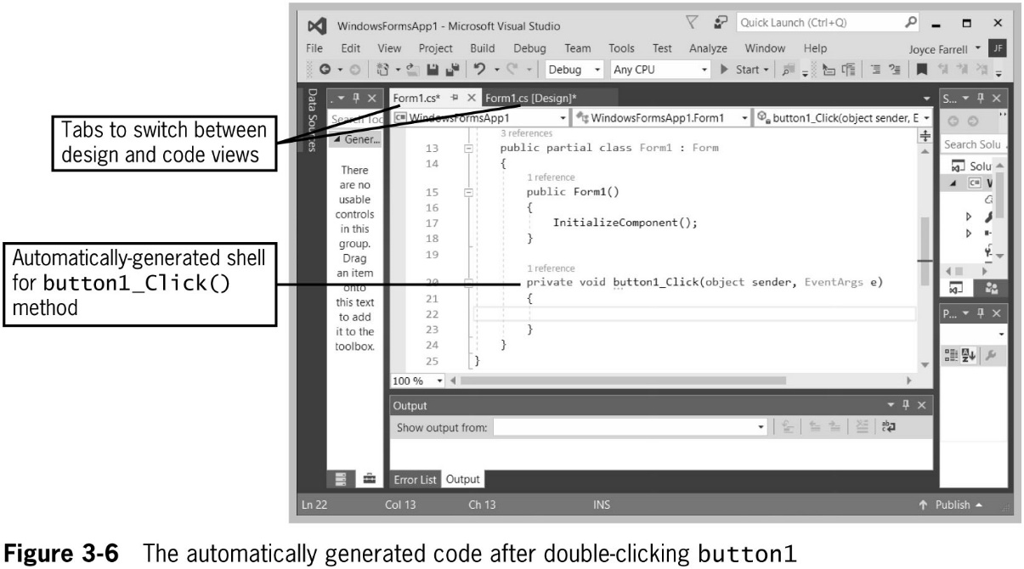
Adding Functionality to a Button on a Form (2 of 5)
© 2018 Cengage. May not be copied, scanned, or duplicated, in whole or in part, except for use as permitted in a license distributed with a certain product or service or otherwise on a password-protected website for classroom use.

Slide 17
Adding Functionality to a Button on a Form (3 of 5)
You will see many generated statements—some confusing, most of which you can ignore
Write code between the curly braces of the button1_Click() method
You have seen the following method header used in console applications:
static void Main()
The GUI application also contains a Main() method that is created automatically
© 2018 Cengage. May not be copied, scanned, or duplicated, in whole or in part, except for use as permitted in a license distributed with a certain product or service or otherwise on a password-protected website for classroom use.

Slide 18
Adding Functionality to a Button on a Form (4 of 5)
The button1_Click() method and the Main() method headers both used the void return type, but the methods differ in the following ways:
The button1_Click() method has a private access specifier, which is a keyword that dictates which types of outside classes can use a method
The Main() method is static and the button1_Click() method is not
The Main() method header contains no parameters between its parentheses, but the button1_Click() method has two parameters
The Main() method identifier begins with an uppercase M, but the button1_Click() method identifier begins with a lowercase b
Events are generated to cause the program to perform a task when a user interacts with a GUI Object
The Click Event occurs when a user clicks on an object like a button
© 2018 Cengage. May not be copied, scanned, or duplicated, in whole or in part, except for use as permitted in a license distributed with a certain product or service or otherwise on a password-protected website for classroom use.

Slide 19
Adding Functionality to a Button on a Form (5 of 5)
If you change the Name property of the button1 object, a subsequently created Click() method will have the same name
You can write anything you want between the curly braces of the button1_Click() method
For example, you can:
Declare variables
Perform arithmetic statements
Produce output
Include block or line comments
© 2018 Cengage. May not be copied, scanned, or duplicated, in whole or in part, except for use as permitted in a license distributed with a certain product or service or otherwise on a password-protected website for classroom use.

Slide 20
Adding Labels and TextBoxes to a Form (1 of 8)
Labels are controls that you use to display text to communicate with an application’s user
You can drag a Label onto a Form, just like a Button
You can change its Text property to display any text you like
Depending on the amount of text, you may need to resize the label
In Figure 3-7, “Enter a number” has been assigned to label1’s Text property
© 2018 Cengage. May not be copied, scanned, or duplicated, in whole or in part, except for use as permitted in a license distributed with a certain product or service or otherwise on a password-protected website for classroom use.

Slide 21
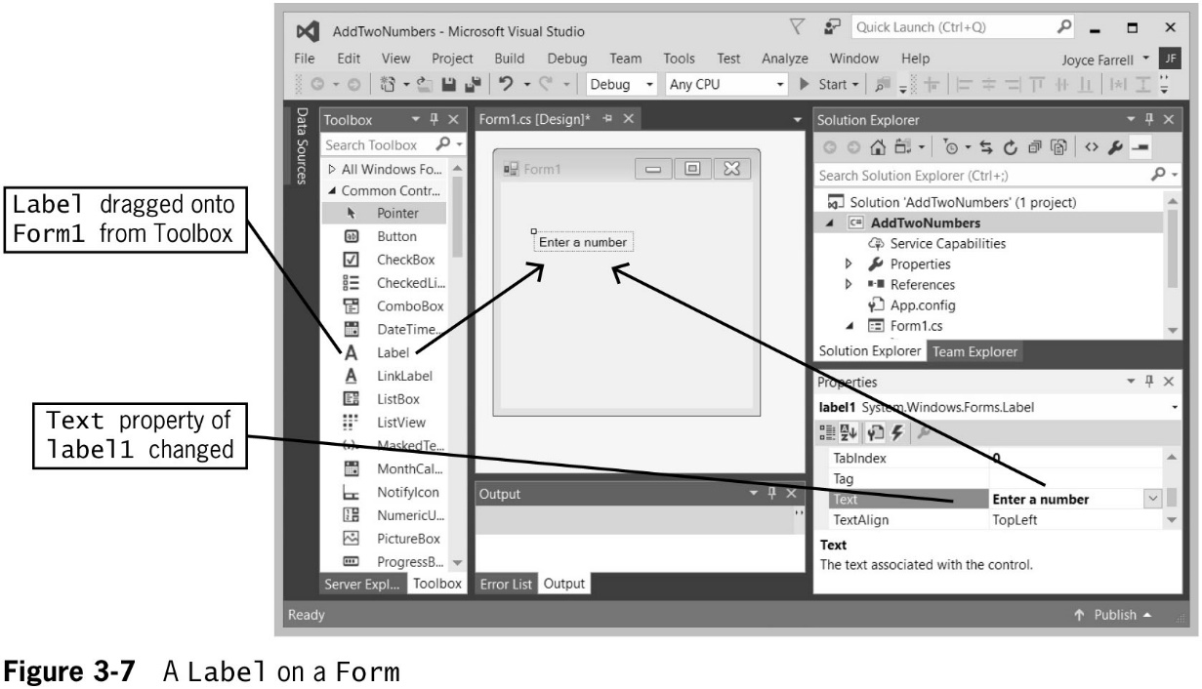
Adding Labels and TextBoxes to a Form (2 of 8)
© 2018 Cengage. May not be copied, scanned, or duplicated, in whole or in part, except for use as permitted in a license distributed with a certain product or service or otherwise on a password-protected website for classroom use.

Slide 22
Adding Labels and TextBoxes to a Form (3 of 8)
TextBoxes are controls through which a user can enter input data in a GUI application
If a user is supposed to enter data in a TextBox, you frequently want to start with its Text property empty
But you are allowed to add text to its Text property if desired
When a user types a value into a TextBox, it becomes the value of the Text property
It is a string by default
If the user is supposed to enter a number, you’ll have to convert it, just as in a console application
© 2018 Cengage. May not be copied, scanned, or duplicated, in whole or in part, except for use as permitted in a license distributed with a certain product or service or otherwise on a password-protected website for classroom use.

Slide 23
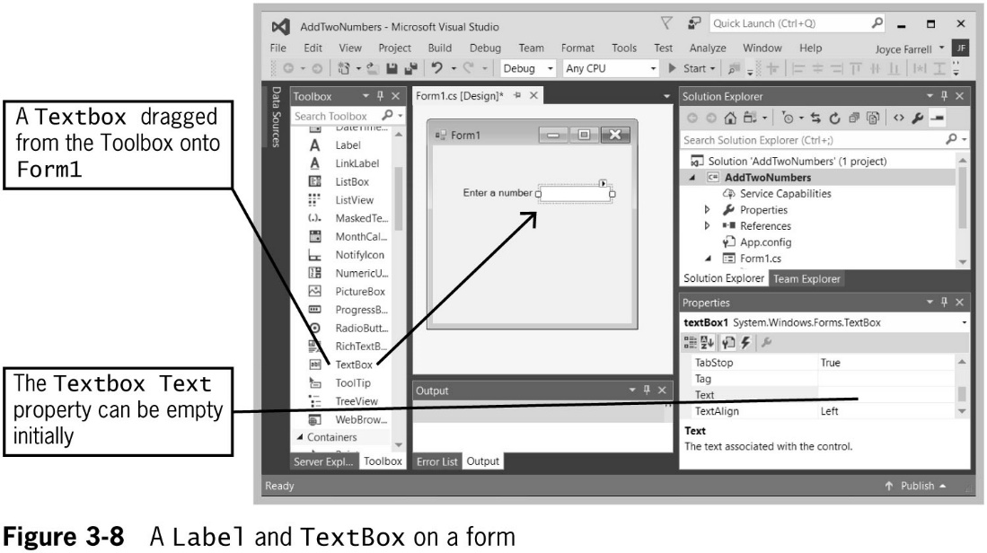
Adding Labels and TextBoxes to a Form (4 of 8)
© 2018 Cengage. May not be copied, scanned, or duplicated, in whole or in part, except for use as permitted in a license distributed with a certain product or service or otherwise on a password-protected website for classroom use.

Slide 24
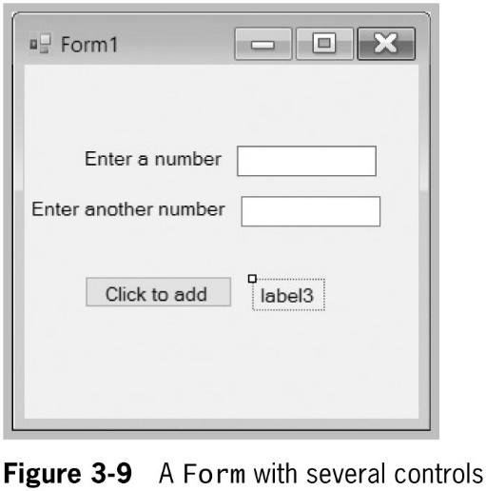
Adding Labels and TextBoxes to a Form (5 of 8)
The form shown here is meant to have the user enter two numbers in the TextBoxes
When the user clicks the Button, the sum of the two numbers will be displayed in label3
You must create the code to do the addition
It goes in the button1_Click() method
© 2018 Cengage. May not be copied, scanned, or duplicated, in whole or in part, except for use as permitted in a license distributed with a certain product or service or otherwise on a password-protected website for classroom use.

Slide 25
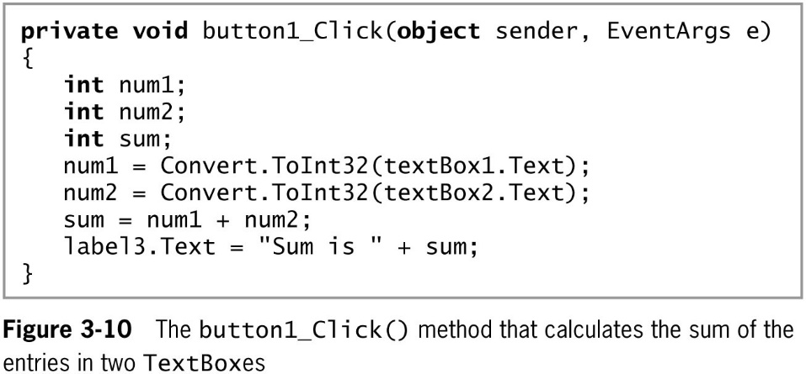
Adding Labels and TextBoxes to a Form (6 of 8)
© 2018 Cengage. May not be copied, scanned, or duplicated, in whole or in part, except for use as permitted in a license distributed with a certain product or service or otherwise on a password-protected website for classroom use.

Slide 26
Adding Labels and TextBoxes to a Form (7 of 8)
To execute a program from the IDE, select Debug from the menu bar, and then Start Without Debugging (or press CTRL + F5)
Figure 3-11 shows how the Form appears when the program executes and the result after the user has entered numbers and clicked the Button
The period during which you design a program is called design time
When you execute a program, the stage is called runtime
© 2018 Cengage. May not be copied, scanned, or duplicated, in whole or in part, except for use as permitted in a license distributed with a certain product or service or otherwise on a password-protected website for classroom use.

Slide 27
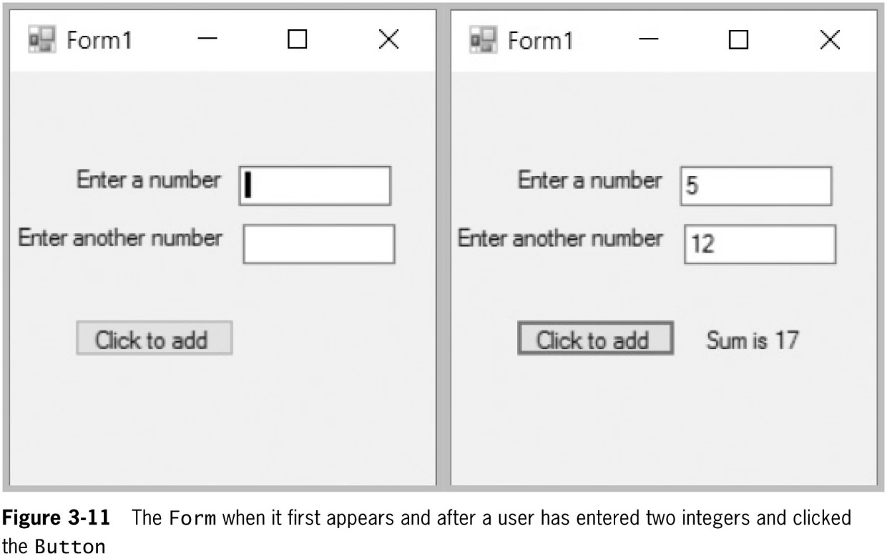
Adding Labels and TextBoxes to a Form (8 of 8)
© 2018 Cengage. May not be copied, scanned, or duplicated, in whole or in part, except for use as permitted in a license distributed with a certain product or service or otherwise on a password-protected website for classroom use.

Slide 28
Understanding Focus and Tab Control (1 of 2)
Focus defines which control is active and will accept keyboard input
A Button that has focus will have a bright line around it
A TextBox that has focus will have a blinking cursor inside it
A control can be given focus by:
The user clicking on the control
The user pressing the Tab key, which will set the focus on the next control as defined by the tab order
© 2018 Cengage. May not be copied, scanned, or duplicated, in whole or in part, except for use as permitted in a license distributed with a certain product or service or otherwise on a password-protected website for classroom use.

Slide 29
Understanding Focus and Tab Control (2 of 2)
Tab order is represented by a sequential number known as the TabIndex
TabIndexes begin with 0
The default tab order is determined by the order in which the controls are added to the form
Unless otherwise specified, the first control to receive focus will have TabIndex 0
You can change a control’s TabIndex value by changing the entry next to TabIndex in the Properties list of the IDE
© 2018 Cengage. May not be copied, scanned, or duplicated, in whole or in part, except for use as permitted in a license distributed with a certain product or service or otherwise on a password-protected website for classroom use.

Slide 30
Formatting Data in GUI Applications
You can use the same format strings as described in Chapter 2 to format strings in GUI applications
Use the String.Format() method to do this
For example, you can display the value on a label with explanatory text and as currency with two decimal places with a statement similar to the following:
Label1.Text = String.Format(“The money value is {0}”,
money.ToString(“C2”));
© 2018 Cengage. May not be copied, scanned, or duplicated, in whole or in part, except for use as permitted in a license distributed with a certain product or service or otherwise on a password-protected website for classroom use.

Slide 31
Changing a Label’s Font
Every control that can contains text has a Font property
Most fonts are proportional fonts, which means that different characters have different pitches or widths.
For example, in Microsoft Sans Serif, a w is wider than an i
The opposite of a proportional font is a fixed-pitch font, or a monospaced font, in which each character has the same width
Courier is an example of a monospaced font
To change the font for a Label
Select the small box with an ellipsis to the right of the existing Font name in the Properties list
Select a new Font from the dialog box that opens
© 2018 Cengage. May not be copied, scanned, or duplicated, in whole or in part, except for use as permitted in a license distributed with a certain product or service or otherwise on a password-protected website for classroom use.

Slide 32
Naming Forms and Controls (1 of 3)
Provide reasonable Name property values for all the controls you place on a Form
Conventionally, start control names with a lowercase letter and use camel casing
Start Form names with an uppercase letter and use Pascal casing
A Form is a class, and C# class names conventionally start with an uppercase letter
Use the type of object in the name
To rename a control after you have generated code for it, use the code refactoring feature
The process of changing a program’s internal structure without changing the way the program works
© 2018 Cengage. May not be copied, scanned, or duplicated, in whole or in part, except for use as permitted in a license distributed with a certain product or service or otherwise on a password-protected website for classroom use.

Slide 33
Naming Forms and Controls (2 of 3)
To refactor the code after changing the button’s name:
View the code and right-click the name of the method button1_Click()
From the menu, click Rename
When you click Rename, the button1_Click method name is highlighted and a box appears with the heading Rename button1_Click
Type the new method name
When you finish, you can check the Preview Changes checkbox if you want to view all the changes before they are applied
© 2018 Cengage. May not be copied, scanned, or duplicated, in whole or in part, except for use as permitted in a license distributed with a certain product or service or otherwise on a password-protected website for classroom use.

Slide 34
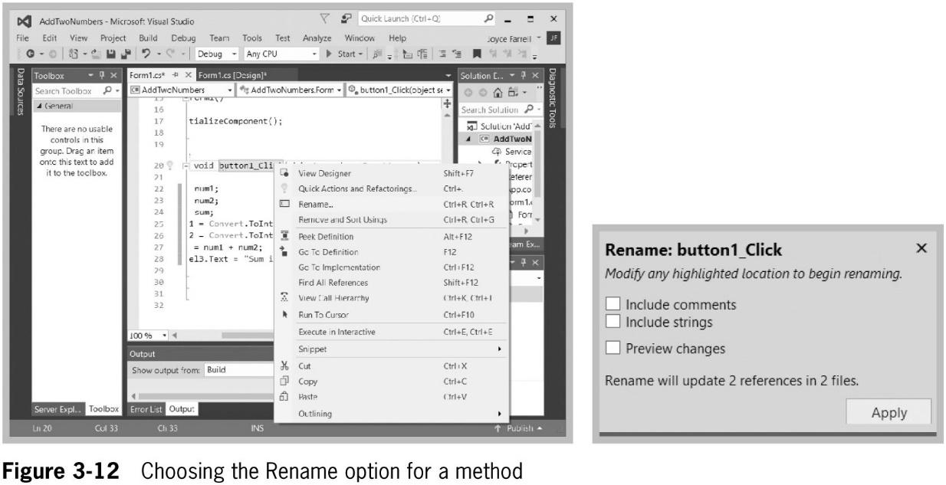
Naming Forms and Controls (3 of 3)
© 2018 Cengage. May not be copied, scanned, or duplicated, in whole or in part, except for use as permitted in a license distributed with a certain product or service or otherwise on a password-protected website for classroom use.

Slide 35
Correcting Errors (1 of 3)
As in console-based programs, you will often generate syntax errors
If you build or run a program with an error, you will see “Build failed” in the lower-left corner of the IDE
You will also see an error dialog box
Always click No in response to “Would you like to continue and run the last successful build?”
Errors will be listed in the error list at the lower-left corner of the screen
Double-clicking an error message will take you to the location in the code where the error was found
© 2018 Cengage. May not be copied, scanned, or duplicated, in whole or in part, except for use as permitted in a license distributed with a certain product or service or otherwise on a password-protected website for classroom use.

Slide 36
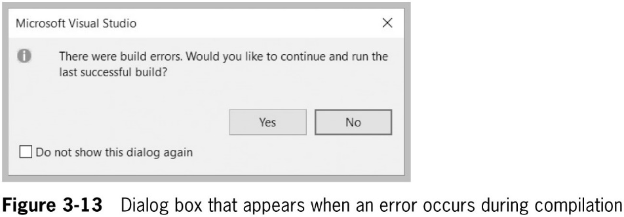
Correcting Errors (2 of 3)
© 2018 Cengage. May not be copied, scanned, or duplicated, in whole or in part, except for use as permitted in a license distributed with a certain product or service or otherwise on a password-protected website for classroom use.

Slide 37
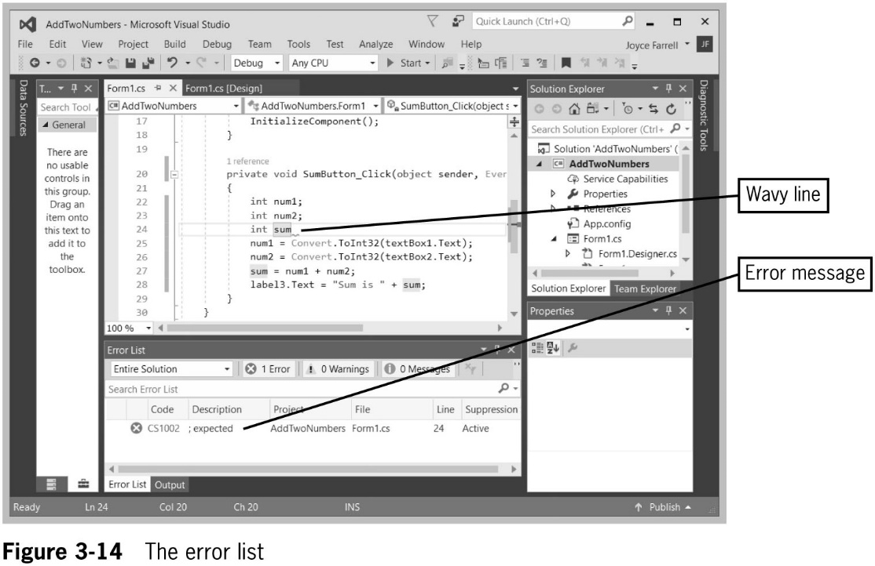
Correcting Errors (3 of 3)
© 2018 Cengage. May not be copied, scanned, or duplicated, in whole or in part, except for use as permitted in a license distributed with a certain product or service or otherwise on a password-protected website for classroom use.

Slide 38
Deleting an Unwanted Event-Handling Method (1 of 2)
When you are working in the Form Designer, it is easy to inadvertently double-click a control and create an event-handling method you don’t want
You can leave the event-handling method empty, but that’s considered bad form
You should not just delete the method because, behind the scenes, other code will have been created that refers to the method
Instead, go to the Properties window of the control, and then click on its Events button, select the button you want to eliminate, and delete the method name
© 2018 Cengage. May not be copied, scanned, or duplicated, in whole or in part, except for use as permitted in a license distributed with a certain product or service or otherwise on a password-protected website for classroom use.

Slide 39
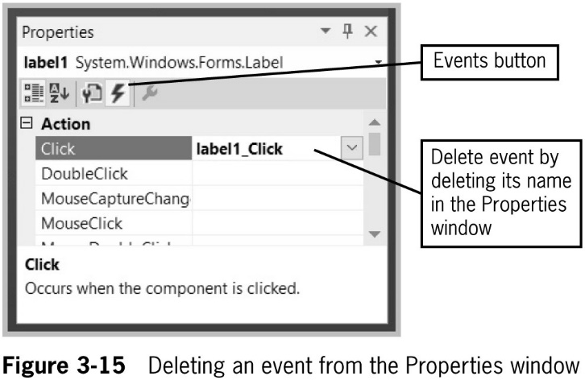
Deleting an Unwanted Event-Handling Method (2 of 2)
© 2018 Cengage. May not be copied, scanned, or duplicated, in whole or in part, except for use as permitted in a license distributed with a certain product or service or otherwise on a password-protected website for classroom use.

Slide 40
Failing to Close a Form Before Attempting to Reexecute a Program
If you make a change to the program and then try to rerun it
You get an error message that indicates that changes are not allowed while the program is running
The solution is simply to close the previous execution of the application and then try again
© 2018 Cengage. May not be copied, scanned, or duplicated, in whole or in part, except for use as permitted in a license distributed with a certain product or service or otherwise on a password-protected website for classroom use.

Slide 41
Using Visual Studio Help
The ultimate authority on C# classes is the Visual Studio Help documentation
The Help documentation for Visual Studio is in the MSDN Library
You can install it locally on your computer
It is also available at http://msdn.microsoft.com
© 2018 Cengage. May not be copied, scanned, or duplicated, in whole or in part, except for use as permitted in a license distributed with a certain product or service or otherwise on a password-protected website for classroom use.

Slide 42
Deciding Which Interface to Use
You have learned to create:
Console applications
GUI applications
Both types contain basic building blocks
GUI applications:
Look “snazzier” and are easy to use
Take longer to develop
Console applications:
Are simpler
May be better when learning new logical constructs
© 2018 Cengage. May not be copied, scanned, or duplicated, in whole or in part, except for use as permitted in a license distributed with a certain product or service or otherwise on a password-protected website for classroom use.

Slide 43
Chapter Summary (1 of 2)
Forms are GUI objects that provide an interface for collecting, displaying, and delivering information
The Toolbox displays a list of available controls you can add to a Form
This list includes Button, CheckBox, and Label
Labels are controls that you use to display text to communicate with an application’s user
Provide reasonable Name property values for all the controls you place on a Form
© 2018 Cengage. May not be copied, scanned, or duplicated, in whole or in part, except for use as permitted in a license distributed with a certain product or service or otherwise on a password-protected website for classroom use.

Slide 44
Chapter Summary (2 of 2)
If you build or run a program that contains a syntax error, you see “Build failed” in the lower-left corner of the IDE and an error dialog box
Both console and GUI applications can contain variables and constants, decisions, loops, arrays, and calls to other methods
GUI applications:
Look “snazzier”
Contain controls that a user can manipulate with a mouse
Usually take longer to develop
© 2018 Cengage. May not be copied, scanned, or duplicated, in whole or in part, except for use as permitted in a license distributed with a certain product or service or otherwise on a password-protected website for classroom use.

